Slide 1
Video display with Qt and OpenCV
Rafael Guimaraes de Paula

Slide 2
Introduction
This presentation is a tutorial of how to use OpenCV and Qt framework to display video.
To install OpenCV and Qt, check the tutorial “install and use OpenCV in Qtcreator” in this link:
https://github.com/rafaelgp23/OpenCVproject/tree/master/Tutorials
<número>

Slide 3
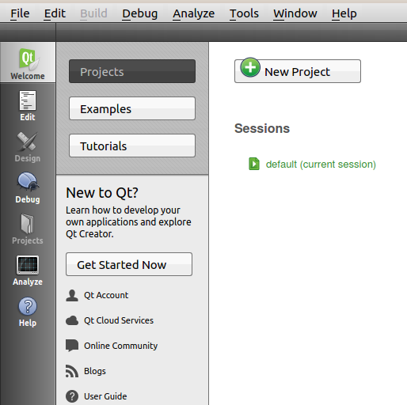
Create a new project
The first step is to create a new project in QtCreator. Click on the button “New Project”.
<número>

Slide 4
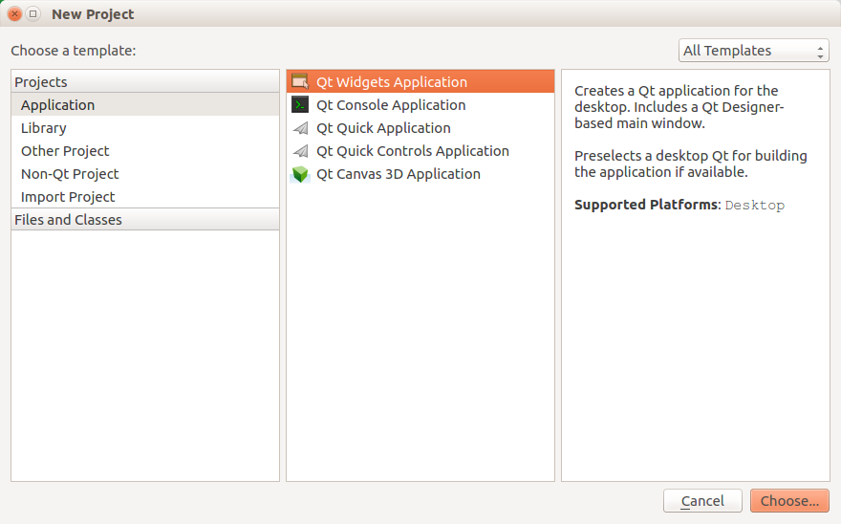
Create a new project
Create a new “Qt Widgets Application“
<número>

Slide 5
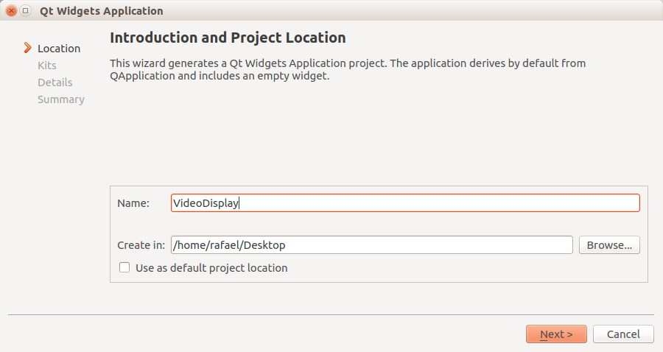
Create a new project
Choose the name of the project and the directory where the project folder will be created. Click the button “Next>”
<número>

Slide 6
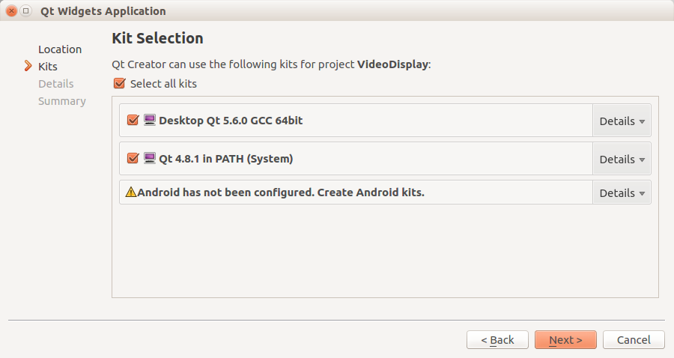
Create a new project
On the Kit Selection window, just make sure that the Qt compiler and the Qt PATH are selected and click “Next>”
<número>

Slide 7
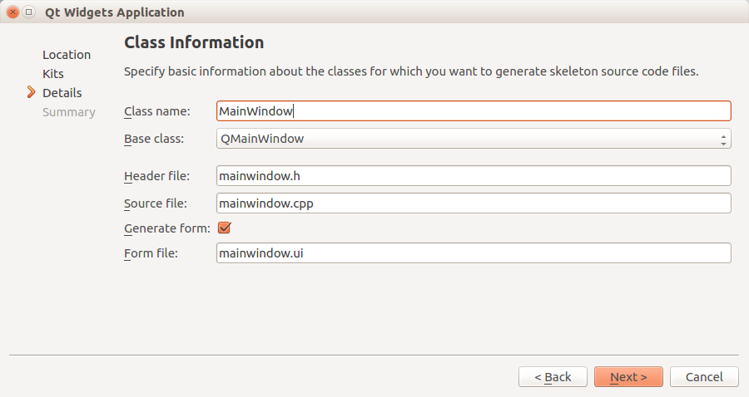
Create a new project
Choose the name of the main window class of your app. The default class name is “MainWindow”. Click “Next>”
<número>

Slide 8
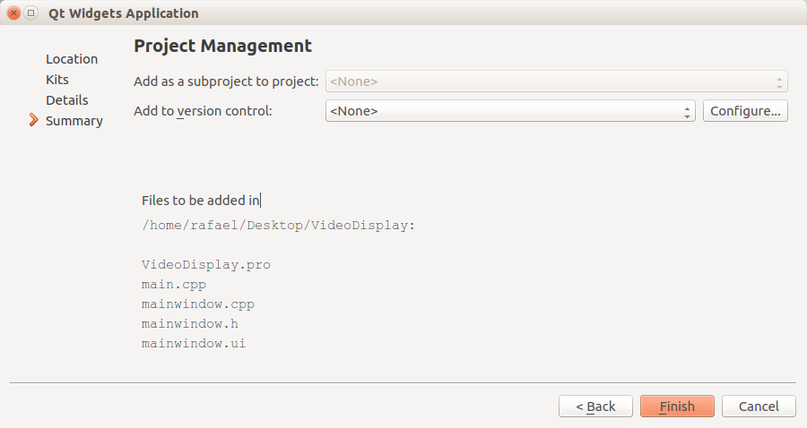
Create a new project
The Summary of all the project options chosen will be displayed. If everything is ok, click “Finish”.
<número>

Slide 9
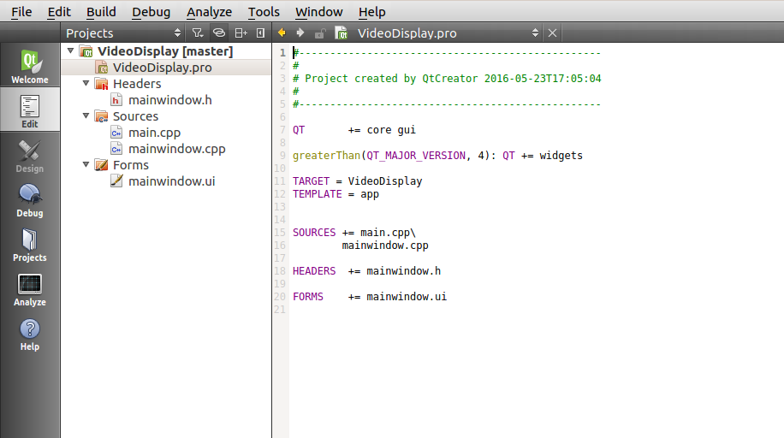
Configure OpenCV in the project
The project has been created but it is still necessary to configure the .pro file in the project to use OpenCV. Open the .pro file.
<número>

Slide 10
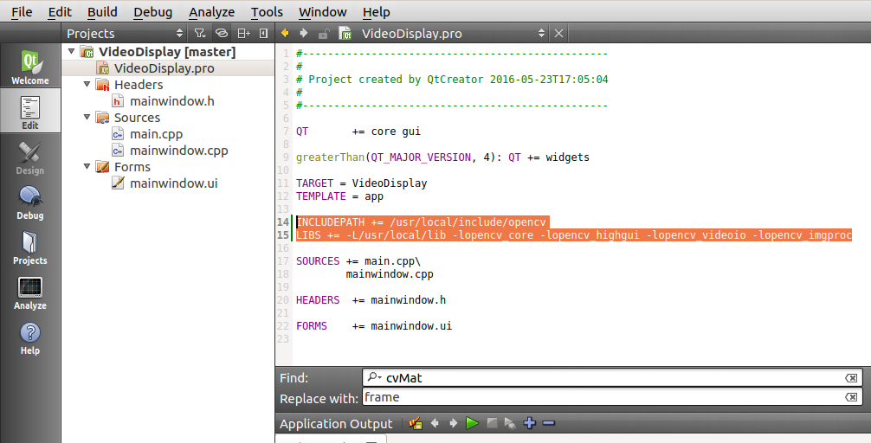
Configure OpenCV in the project
Add the following lines before “SOURCES”:
INCLUDEPATH += /usr/local/include/opencv
LIBS += -L/usr/local/lib -lopencv_core -lopencv_highgui -lopencv_videoio -lopencv_imgproc
If you try to include an OpenCV library in your project later, make sure that this library is included in LIBS line.
<número>

Slide 11
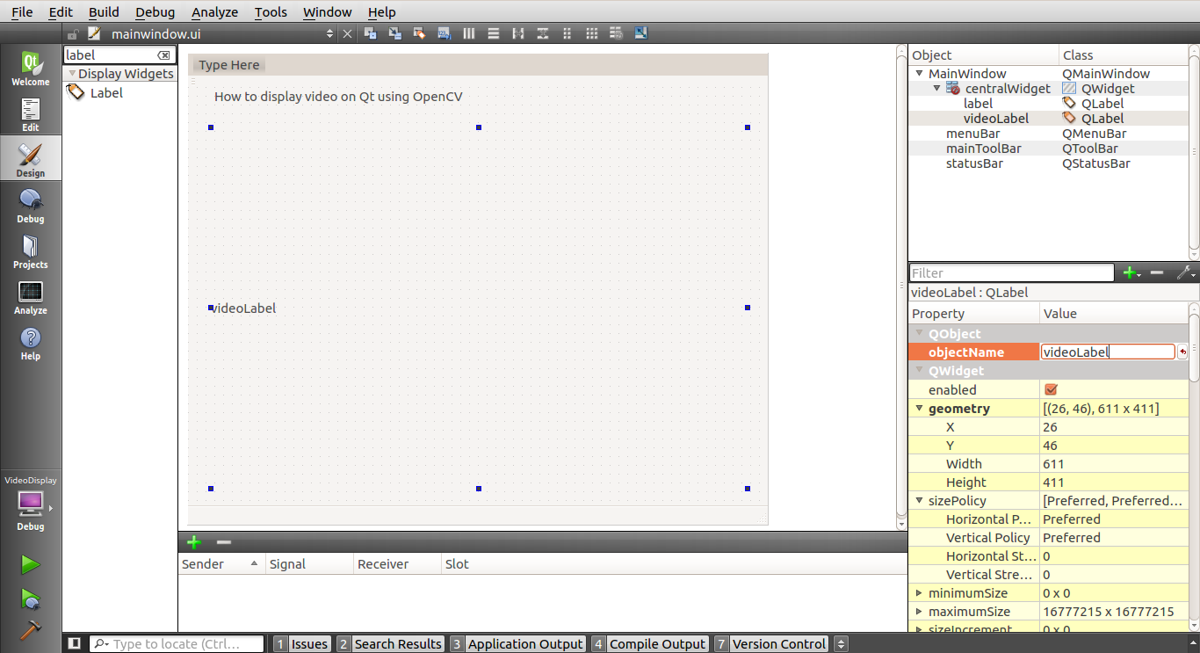
MainWindow.ui
Open the MainWindow UI (user interface) design page and add a QLabel on the ui. Remember the label object name to refer to it when implementing the code.
<número>

Slide 12
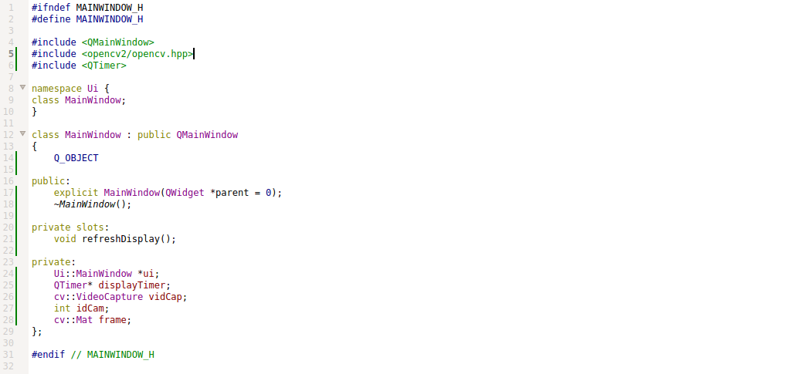
MainWindow.h
<número>

Slide 13
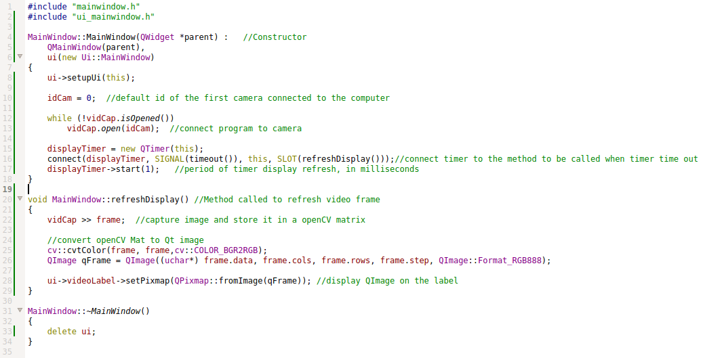
MainWindow.cpp
<número>

Slide 14
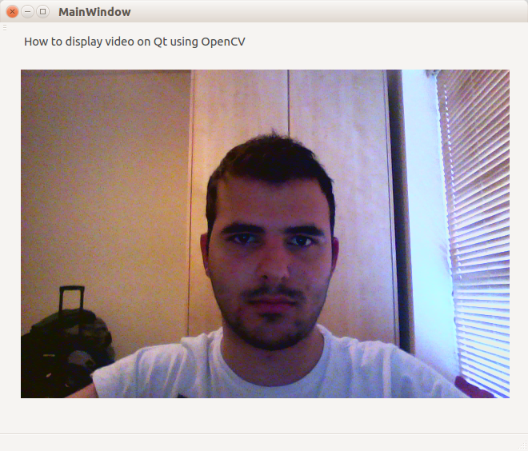
Result
<número>

Slide 15
Thank You!
<número>

